Slide 1
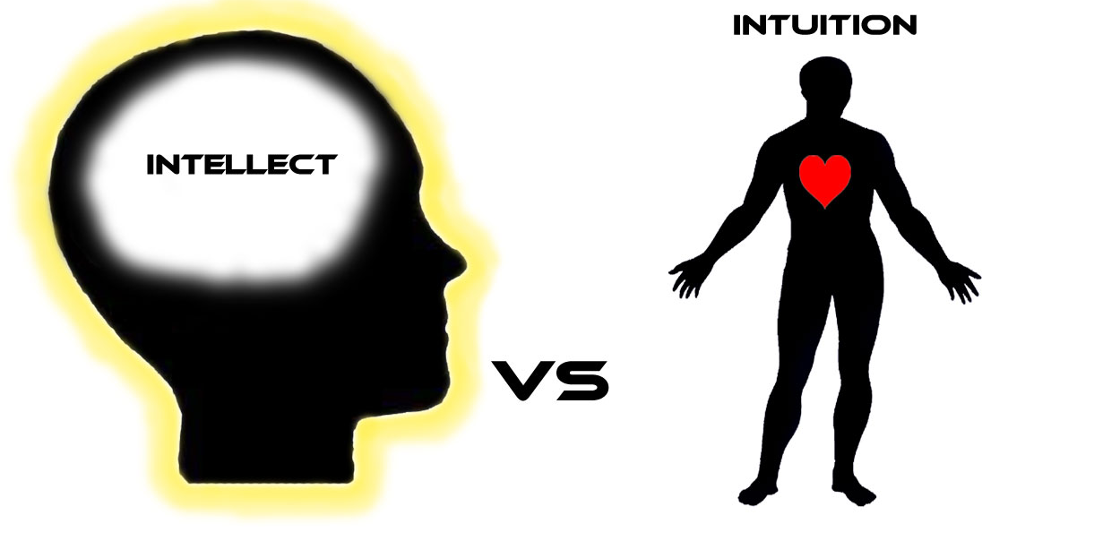
Intuition in Futures Work University of Houston Graduate Foresight Program 7th Annual Spring Gathering, April 21 – 22, 2017 Oliver Markley, Ph.D. Professor Emeritus, Graduate Studies of the Future University of Houston-Clear Lake
Notes:
Glad to be here to talk BRIEFLY about a
When Andy announced the 2017 Spring Futures gathering, I suggested that it might be appropriate to me to do a 5 min. presentation on the recent symposium in the Journal of Futures Studies on INTUITION IN FUTURES WORK -shift-

Slide 2
Notes:
That was awarded a MOST SIGNIFICANT FUTURES WORK by the APF. Andy said, “how about 15 minutes instead?” So thanks, Andy, for the opportunity; and thanks as well for nominating this work for the competition.

Slide 3
Symposium on ‘Intuition in Futures Work’
Journal of Futures Studies, Vol 20 No 1 (Sept. 2015)
Introduction to the Symposium on ‘Intuition in Futures Work’
Oliver Markley
The Inner Game of Futures
José M. Ramos
Applying Intuitive Methods in Explorations of Preferred Futures
Ruth-Ellen L. Miller
Intuition and Evolution –How I Find It Essential to Use Intuition in My Futures Work
Barbara Marx Hubbard
Intuiting the Future(s)
Sohail Inayatullah
Learning to Use Intuition in Futures Studies: A Bibliographic Essay on Personal Sources, Processes and Concerns
Oliver Markley
Classical Intuition and Critical Futures
Marcus T. Anthony
Intuition, Rationality and Imagination
Marcus Bussey
Notes:
The origin … 2015 lunch in Singapore with Sohail… “proudest prouds and sorriest sorries” … Today I just want to hit some of the high points of a literature search on executive intuition that I covered in the introduction; as well as some practical advice on how to use intuition-based visioning for preferred futures., with hyperlinks so that you can access them online. Or…[thumb drive]

Slide 4
Best definition of intuition
Non[egoic]-conscious process
involving holistic associations
that are produced rapidly, which
result in affectively charged judgments.
Source: Eric Dane & Michael Pratt (2007Exploring intuition and its role in managerial decision making," Academy of Management Review, 32/1, 33-54.
Notes:
Many, many definitions in the literature of the ephemeral phenomenon called intuition.

Slide 5
Six Overlapping Functions of Intuition
Discovery / Serendipity
Creativity / Innovation
Evaluation / Option choosing
Operation / Being in the right place at the right time
Prediction / Foresight
Illumination / Transcendence
Source: Philip Goldberg (1983) The Many Faces of Intuition; Summarized in Weston Agor (1989), Intuition in Organizations.
Notes:
These sources treat each of these in depth. Highly worth reviewing.

Slide 6
Where to Use Practical Intuition
Better
Worse
In situations involving novelty, uncertainty, and time pressure (immediacy of decision), where rational methods break down.
In situations involving regularity, high data availability, etc. where rational methods do better.
Sources: Erik Dane & Michael Pratt (2007),
Exploring intuition and its role in managerial decision making, Academy of Management Review, 32(1), 33-54.
Eugene Sadler-Smith (2008) The role of intuition in collective
learning and the development of shared meaning,
Advances in Developing Human Resources, 10 (4), 494-508.

Slide 7
Methods for Developing Intuitive Awareness
Passive volition
Meditation
Mindfulness
Somatic awareness
Insight
Spontaneity
Visual imagery
Relaxation
Described by Sadler-Smith & Shefy (2007), “Developing Intuitive Awareness in Management Education,” Academy of Management Learning & Education, 6(2), 494-508.
Dream work
Holotropic/Integrative Breathwork
Brainwave Entrainment (BWE)
Psychochemicals
Highly relevant methods for tapping intuition through non-ordinary states of consciousness (NOSC) not described by Sadler-Smith & Shefy

Slide 8
Three Types of Practical Intuition
1. Automated expertise or “job smarts”
(memory dependent)
2. Holistic hunch or "gut” feeling
(memory influenced)
3. Transcendental insight or vision
(memory independent)
Sources: The first two are distinguished by C. Chet Miller and R. Duane Ireland (2005), “Intuition in strategic decision making: Friend or foe in the fast-paced 21st century”, Academy of Management Executive, 19/1, 19-30. The third is by Markley.

Slide 9
1. Automated Expertise
Definition
Examples
Judgment or choice made through a partially subconscious process involving:
Steps learned from situation-specific experiences
A replay of past learning
A feeling of familiarity
Large bank loan officer making routine loan decisions
Airline pilots or fire chiefs making instantaneous crisis decisions
Everyone who trusts their “savvy” in rapid response situations

Slide 10
2. Holistic Hunch / Gut Feeling
Definition
Examples
Judgment or choice made through a subconscious process involving:
Synthesis of diverse experiences
Novel combinations of information
Strong feelings of being right
Ray Croc’s decision to buy the McDonalds brand
Chrysler’s decision to develop the Dodge Viper;
Honda’s decision to introduce motorcycles in the U.S.
Peak performing executives who trust “gut feelings” in uncertain situations

Slide 11
3. Transcendental Inspiration
Definition
Examples
Judgment or choice made through a “supraconscious” process involving:
A non-ordinary level or state of consciousness (NOSC)
A sense of how something should be rectified or made more whole
Often comes as a sudden flash of insight
Being inspired by an inner daemon or muse
Niels Bohr dreaming of a planetary system as a model for atomic structure that won the Nobel Prize
Ordinary people of all types who have opened their inner channels of wisdom and creativity through human potential courses, meditation, etc.

Slide 12
Mental Time Travel: A practical business and personal research tool for looking ahead (Futures, Vol. 40, 2008, 17–24)
Helps to experientially answer:
What may happen if ‘‘X’’ (a decision or policy option) is chosen, versus is not chosen and implemented? In particular, how would it feel to live in each such contingent future?
Which of two policy options or possible decisions looks and feels better, ‘‘X’’ or ‘‘Y’’?
In a scenario described in advance, what significant impacts are likely, but are as yet unrecognized? How would such impacts feel to stakeholders at various levels of aggregation, (individual, family, work group, subculture/ecology, global culture/ecology)?
Notes:
The hyperlink is to author’s copy to be shared only with colleagues; the article includes both a bit of theory, illustrative case examples, and a step by step process recipe for doing it.

Slide 13
Ruth Miller’s Basic Process for Intuition of Preferred Future Source: Applying Intuitive Methods in Explorations of Preferred Futures, p. 104
Breathe long and slow, be quiet, and “enter the Silence”, the state of consciousness in which normal mind chatter is reduced or even eliminated;
Learn to focus the attention on one thought, one process, one image until there is no though except that one;
Listen for what has been called “the still small voice” within; be expectant;
Allow whatever sound or image or space that emerges, however vague, to take shape, using as many internal senses as possible – sight, hearing, taste, touch, smell;
Though the normal reaction is to ignore it and wait for something clearer, focus on whatever vague thought, image, or urge that emerges, without censoring, changing, or trying to make sense of it. (This free expression is essential in order to begin to undo the old training and habit of ignoring and censoring what comes from within.)
Continue to focus on it until it seems complete;
Return slowly and gradually to normal waking consciousness with the explicit intention of remembering and using the information and/or experience gained in the altered state, and write down and act upon the experience.

Slide 14
Sohail Inayatullah’s Method for Preferred Futures Visioning Source: Intuiting the Future(s), pp.116-117
When I run a group through visioning, using as context, the work of Elise Boulding (1995), Oliver Markley (1992), David Loye (2004) and others, I have them close their eyes and imagine a happy time in their life, as I wish for them to feel their way into the future. Earlier methods in the workshop process (the futures triangle, for example) have been heavily cognitive, and thus, I wish to move participants to a different part of their brain, a different ‘self’, And indeed even to access the extra-cerebral part of themselves, i.e. the collective mind in the room. Once they have accessed this feeling, we walk - in the mind’s eye - into the future, often fifteen steps, for example, to the year 2030. They walk up to a hedge, which represents the boundary to the preferred future (not predicted, as I do not wish to privilege the psychic but the preferred, what they truly wish for). A gate opens and they walk into the the desired future, allowing images of what-is to come to them. For a few minutes, they explore this desired future. They then see a six story building in front of them. The six story building is a representation of the chakras. They then go up a spiral staircase (the kundalini in Tantra) to the sixth floor (the eye of intuition) and walk toward a balcony. There, they meet their future self (or friend, mentor, or guru, or...) who gives them a message. They read the message to themselves and after bowing down (acknowledging the wisdom of a force beyond the directed self ), they walk back down the staircase and then slowly walk back toward the hedge. Going back through the gate, we retrace the steps back to the present.
Participants then, if they wish to, share their visions and messages. This process succeeds in that it helps synthesize the thoughts and analysis of the past few days of the foresight course.
Notes:
That’s enough for now. Before opening things for Q&A, useful to provide a listing of my visioning publicvaitons

Slide 15
A Bit of Theory About Transcendental Intuition in Visioning
Expanded Pre-print and YouTube Video on “Imaginal Visioning for PropheticForesight”
(Journal of Futures Studies, 2012)

Slide 16
Concepts Underlying Cornucopia Causality/Transcendental Intuition
Secular
Morphogenic Field & Morphogenisis (Sheldrake)
Implicate to Explicate Domain (Bohm)
Sub-quantum Akashic / Imaginal Field (Laszlo)
Spiritual
Holy Spirit (Christian)
Schechinah (Jewish)
Illuminationism (Islam)
Alayavijnana (Buddhist)

Slide 17
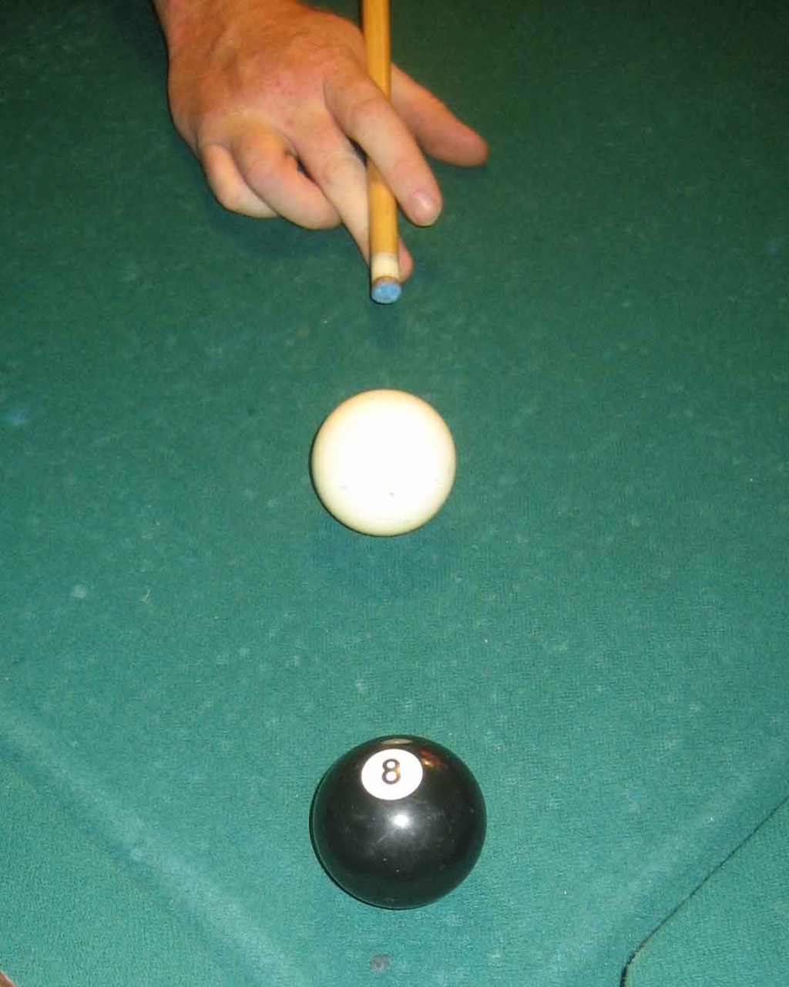
Cornucopia ~ Billiard Ball Causality (“Power vs. Force”)
(~)

Slide 18
Integrative Foresight
Cornucopia Causality
Passive Volition / Willing /Yin
Receptive
Imaginal Visioning
Intuitive Feeling
Prophetic Foresight
Billiard Ball Causality
Active Volition / Willful / Yang
Expressive
Imaginative Visualizing
Rational Thinking
Conventional Foresight
~
Eventually, reintegrating reason and intuition may prove to be one of the primary contributions of systems thinking.
Peter Senge

Slide 19
Historical Listing of my Visioning Publications
Using Depth Intuition Methods for Creative Problem Solving and Strategic Innovation (1988/1992)
Experiencing the Needs of Future Generations (1994)
Mental Time Travel: A Practical Tool for Looking Ahead (1994/2007)
Visionary Futures: Guided Cognitive Imagery for Teaching and Learning about the Future (1998)
Imaginal Visioning for Prophetic Foresight
[Expanded Pre-print], YouTube Video (2012)
Aspirational Guidance for Wiser Futures (2015)
“Introduction to the Symposium on Intuition in Futures Work” and “Learning to Use Intuition in Futures Work” (Journal of Futures Studies, Vol. 20, 2015)

